Slide 1




Using Thermal Inertia to Estimate Particle Size on Asteroid Bennu for OSIRIS-REx
Ashley Nied-University of Arizona
Dante S Lauretta-Osiris-REx PI
Derek Richardson & Joe Demartini-University of Maryland
Space Grant Symposium April 16, 2016 LPL UA
Notes:
Front slide: NEED date and place… take away blue. Better format
Second slide explaining OREX
Thank you more broad to SG

Slide 2
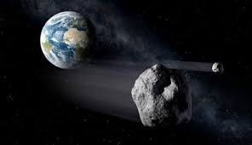
OSIRIS-REx
O-origins
S-spectral
I-interpretation
R-resource
I-identification
S-security
R-regolith
Ex-explorer

Slide 3
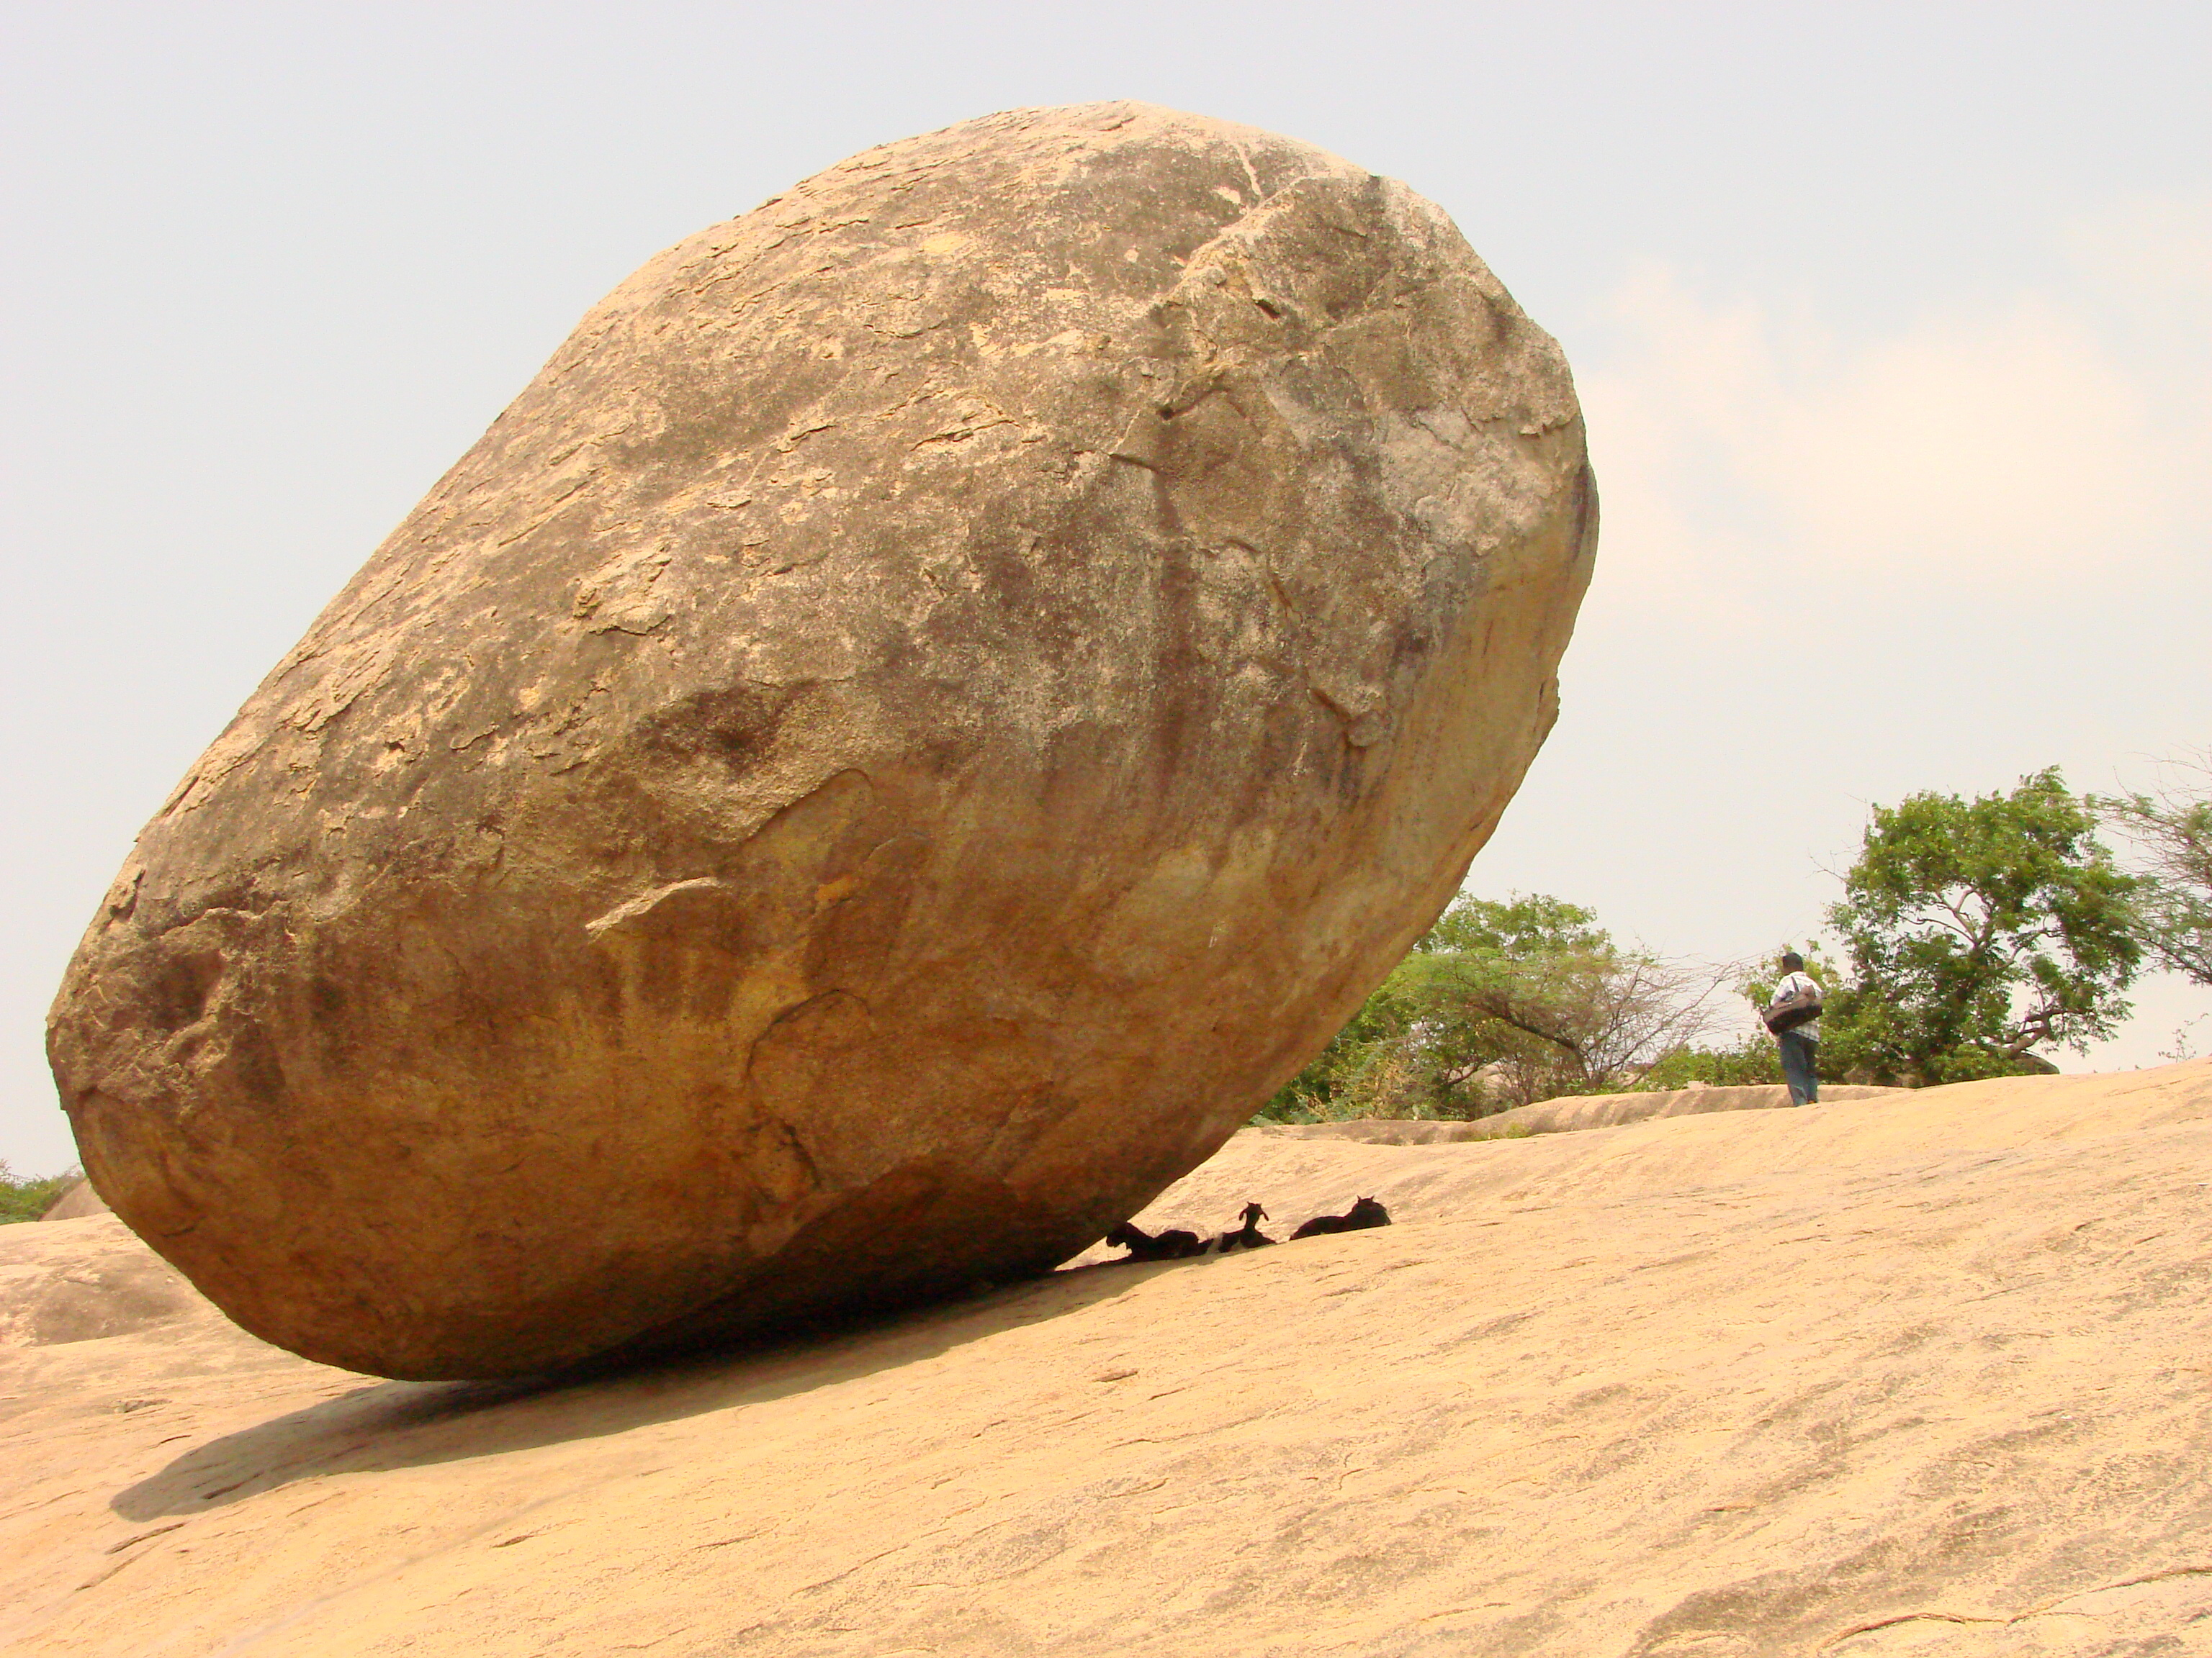



Thermal Inertia?
Equation:
heat conductivity(K), porosity(∅)
specific heat capacity($∁$), and
mass density($ρ$)
Factors: grain shape, grain size, type of material
$$I=\sqrt{K∅∁ρ}$$
Notes:
https://www.google.com/url?sa
https://www.google.com/imgres?imgurl

Slide 4
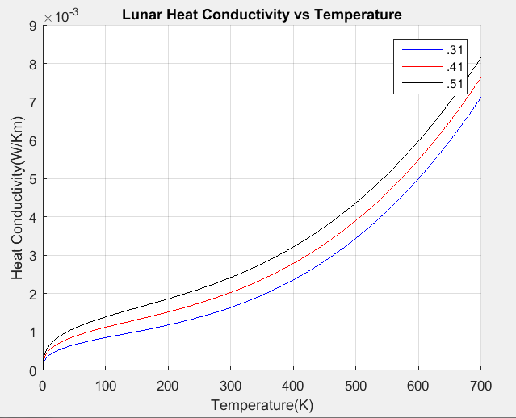
Background
Gundlach and Blum’s method published 2012
Calculate an “ideal” heat conductivity and a measured heat conductivity from thermal inertia
Plot the two curves against one another
Porosity

Slide 5
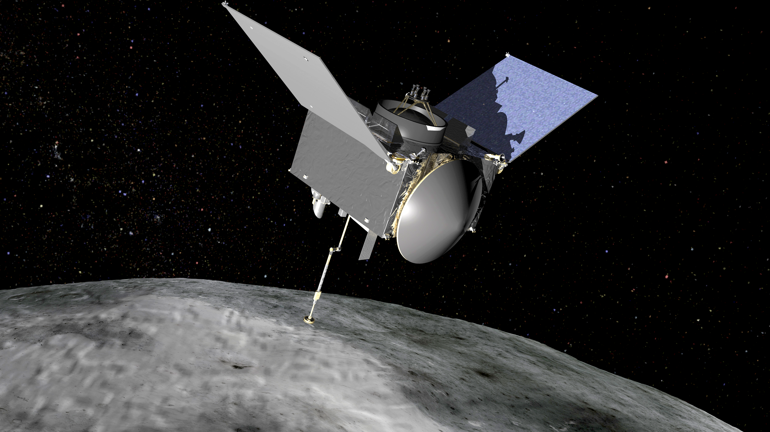
Goals:
Create a process to test the validity of the method
Determine if there are patterns between the observed values of thermal inertia and grain shape, grain size, and grain type

Slide 6
Methods
Experimental matrix: To determine the factors that influence thermal inertia
Factors: size, shape, type of asteroid
Particle Size | Particle Shape | Grain Density | Heat Capacity | Thermal Inertia
1 cm | Sphere | Carbonaceous | Carbonaceous | ?
3 cm | Tetrahedral | Stony | Stony | ?
5 cm | Cube | Metallic | Metallic | ?

Slide 7
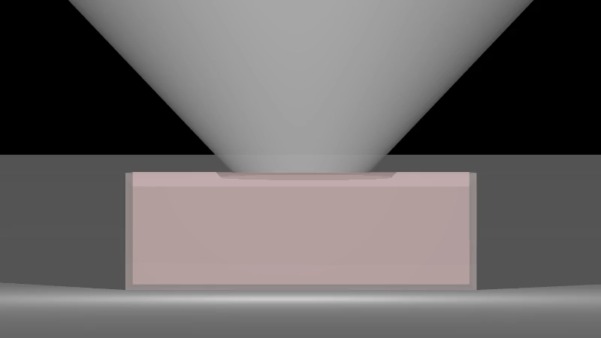
Methods
Linux-Based Pkdgrav for simulations
Matlab to calculate thermal inertia values
Input back into experimental matrix

Slide 8
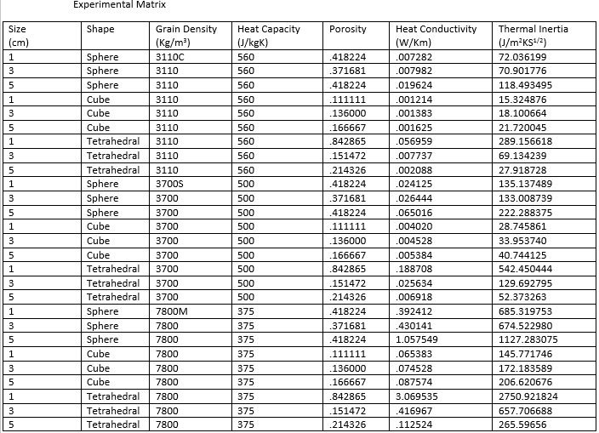
Results

Slide 9
Interpreting the Results
All 1 cm | Carbonaceous | Stony | Metallic
Sphere | 72 | 135 | 695
Tetrahedral | 289 | 542 | 2750
Cube | 15 | 28 | 145
The thermal inertia values do not correlate directly to grain size.
The type of asteroid as well as the shape of the particle effect the resulting thermal inertia value.
Which factor influences the resulting thermal inertia values most?
All 3 cm | Carbonaceous | Stony | Metallic
Sphere | 70 | 133 | 674
Tetrahedral | 69 | 129 | 657
Cube | 18 | 33 | 172
All 5 cm | Carbonaceous | Stony | Metallic
Sphere | 118 | 222 | 1127
Tetrahedral | 27 | 52 | 265
Cube | 21 | 40 | 206

Slide 10

Interpretations
Helps OSIRIS-REx mission determine a sample site
Checking current astronomical methods
Potentially assist future space missions

Slide 11

Thank you!
Special thanks to:
-Dante S Lauretta for being a great mentor and providing me with many opportunities.
-Derek Richardson and student Joe DeMartini for helping with Pkdgrav
-Everyone with Space Grant
-NASA contract NNM10AA1C

